Slide 1
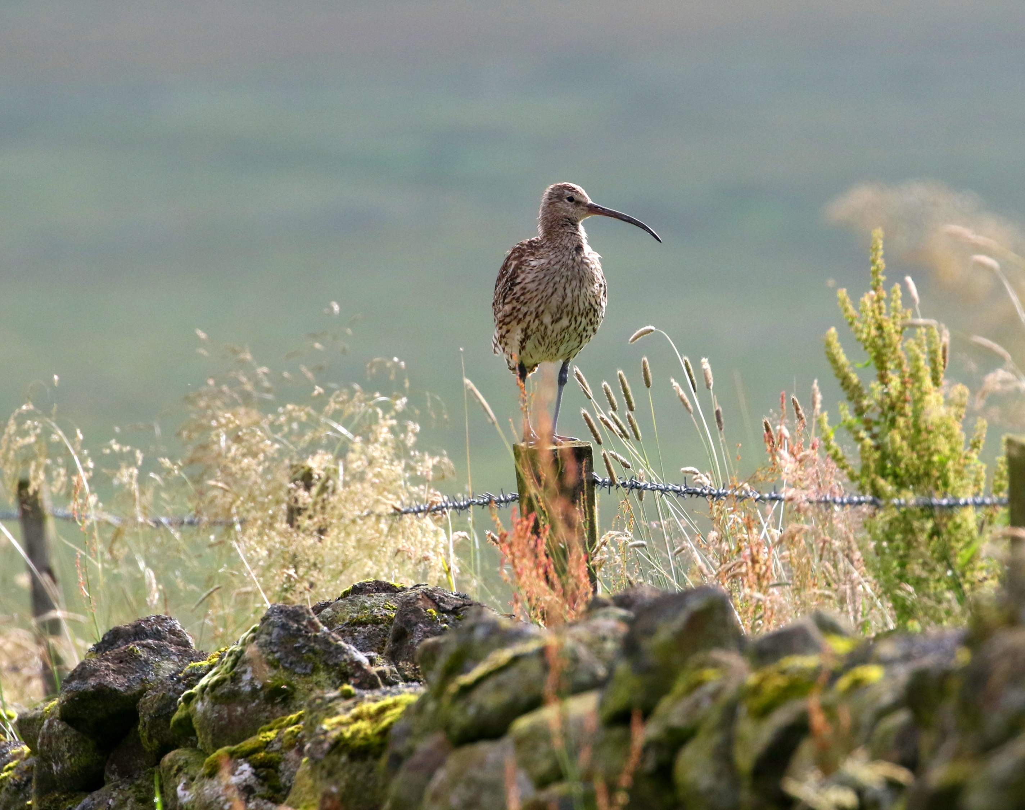

Biodiversity targets in Northern Ireland: where, what, and what next?
Dr. Jane Clarke
Nature Protection Policy Officer, RSPB Northern Ireland
Chair Nature & Environmental Protection Working Group, NIEL
22nd September 2022
Curlew, credit: Neal Warnock

Slide 2
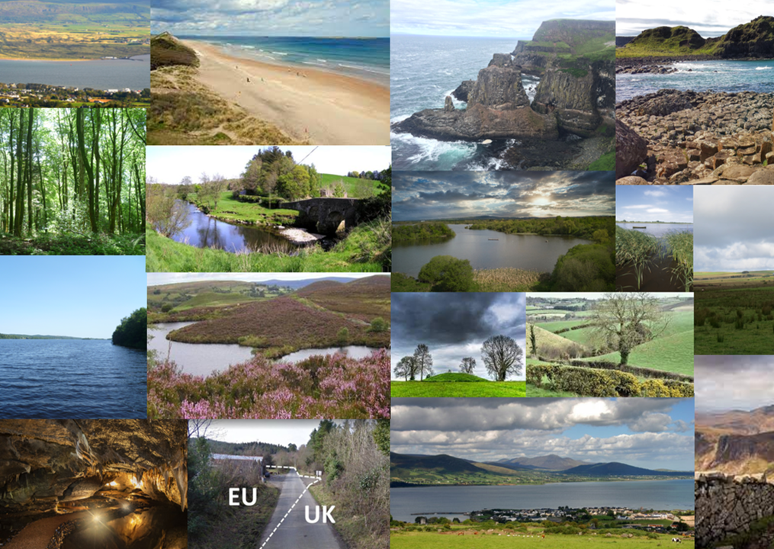
12th worst in the world for biodiversity loss.
11% species at risk from extinction.
1 out of 49 priority habitats in good condition.
No rivers, lakes, or coastal waters in good overall status.

Slide 3
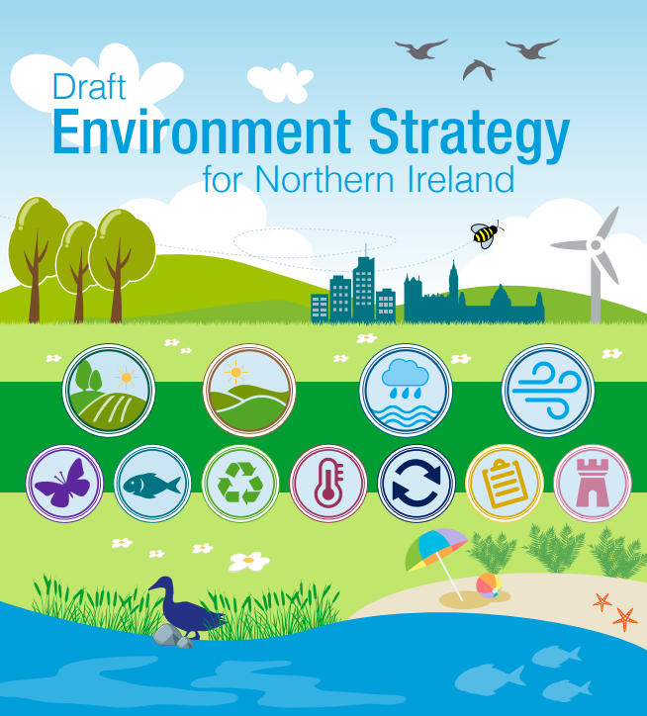
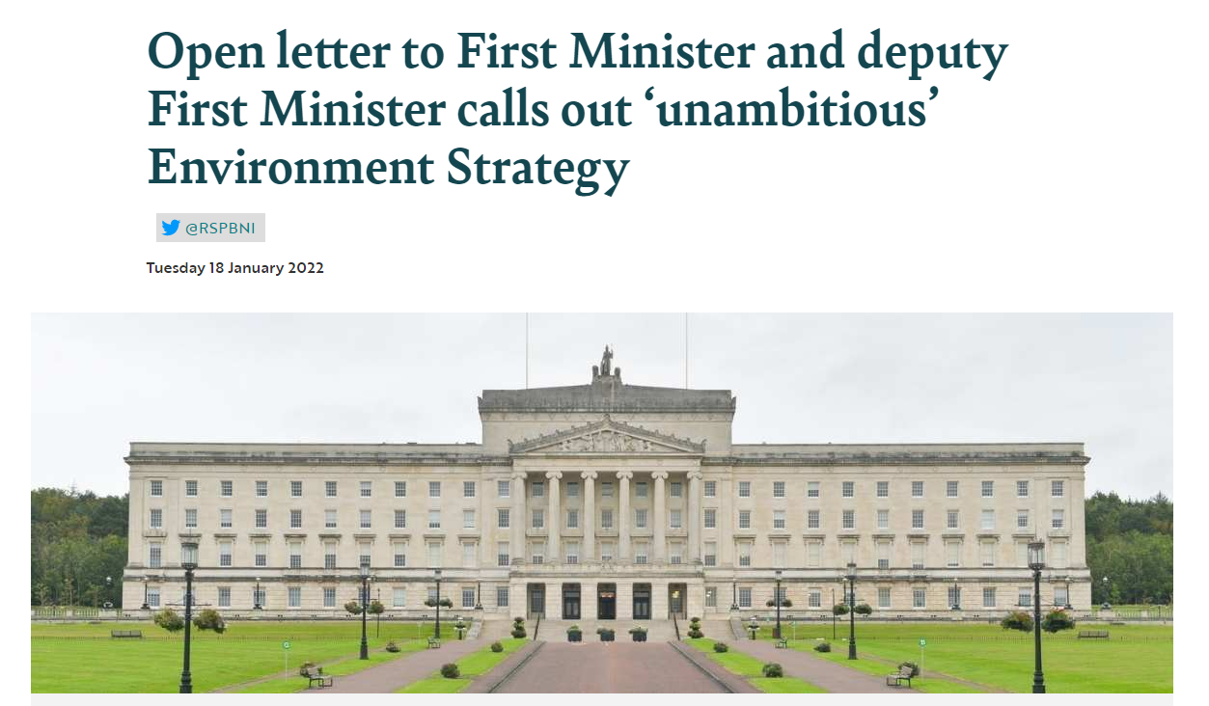
The draft Environment Strategy
Environment Act 2021: environmental improvement plan.
6 Strategic Environmental Outcomes.
225 actions and targets:
  76% (172) have no timeframe,
  78% (177) either partly or completely unmeasurable.
Lack of ambition and coherence.
Not respond to all drivers of loss.
Targets not legally binding.
Final strategy to be published by 25th July 2023.

Slide 4
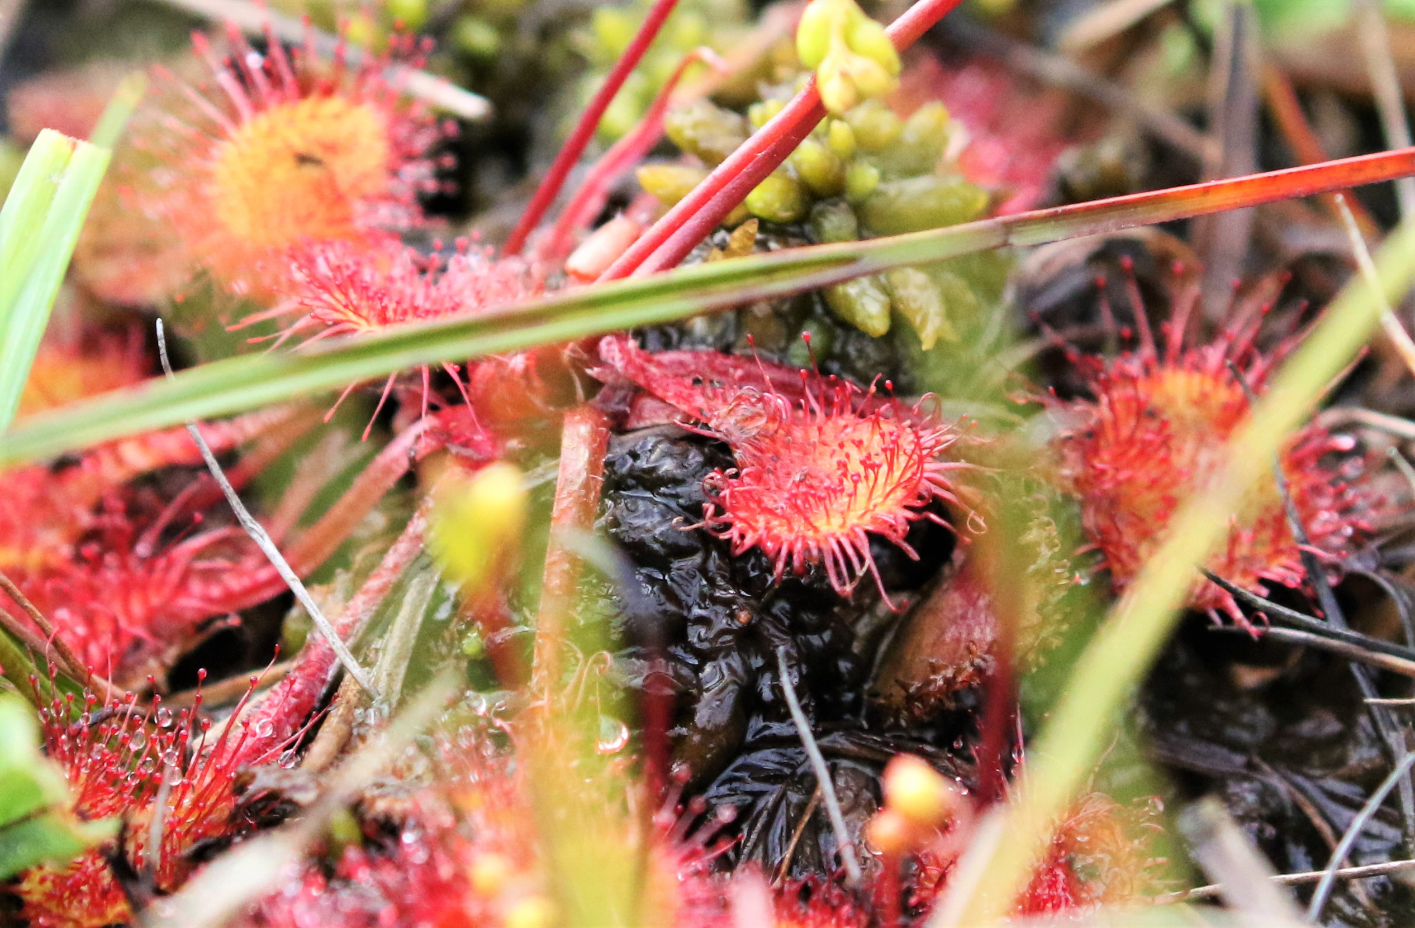
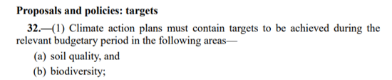
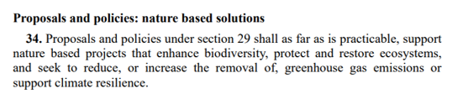
The Climate Change (NI) Act 2022
Net zero by 2050 with exemptions for methane (46%)
Climate Action Plan:
  Biodiversity and soil quality targets.
  Nature-based solutions.
Cross-departmental duties and requirement for cross-border collaboration.
Potential conflict between targets for net zero and for nature’s recovery.
3 months into 24 month time-frame for targets (June 2024)
Round leaved sundew. Credit: Neal Warnock

Slide 5
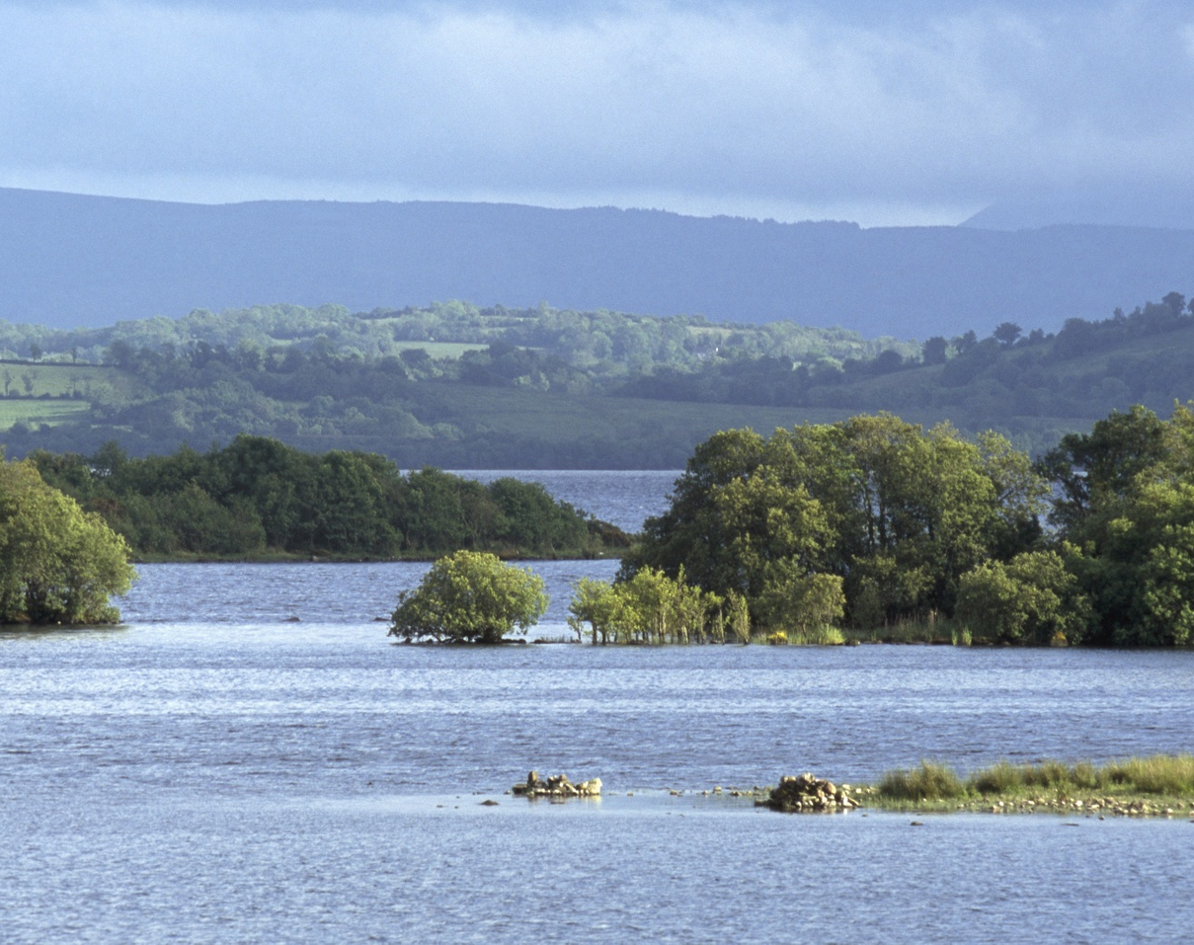
The Biodiversity Strategy
NI’s Biodiversity Strategy 2015-2020
  83% targets/actions missed by Government
Co-design process?
Lack of consistency (and ambition) in targets.
Draft strategy consultation expected after CBD COP15.
Not legally binding.
Lower Lough Erne. Credit Andy Hay

Slide 6
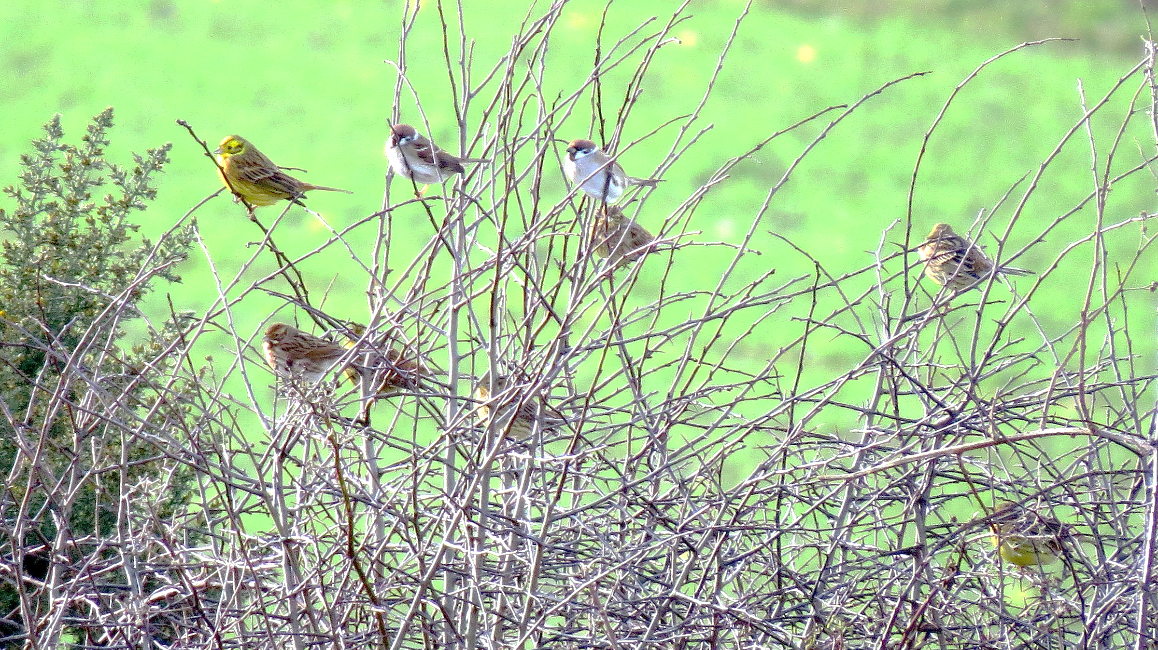
Intra-UK divergence
Divergence is not inherently a bad thing.
Without political institutions/will = lowest common denominator?
Race to the bottom.
UK-wide (centralised) decision-making.
UK-wide reporting to Convention on Biological Diversity.
Creates uncertainty.

Slide 7
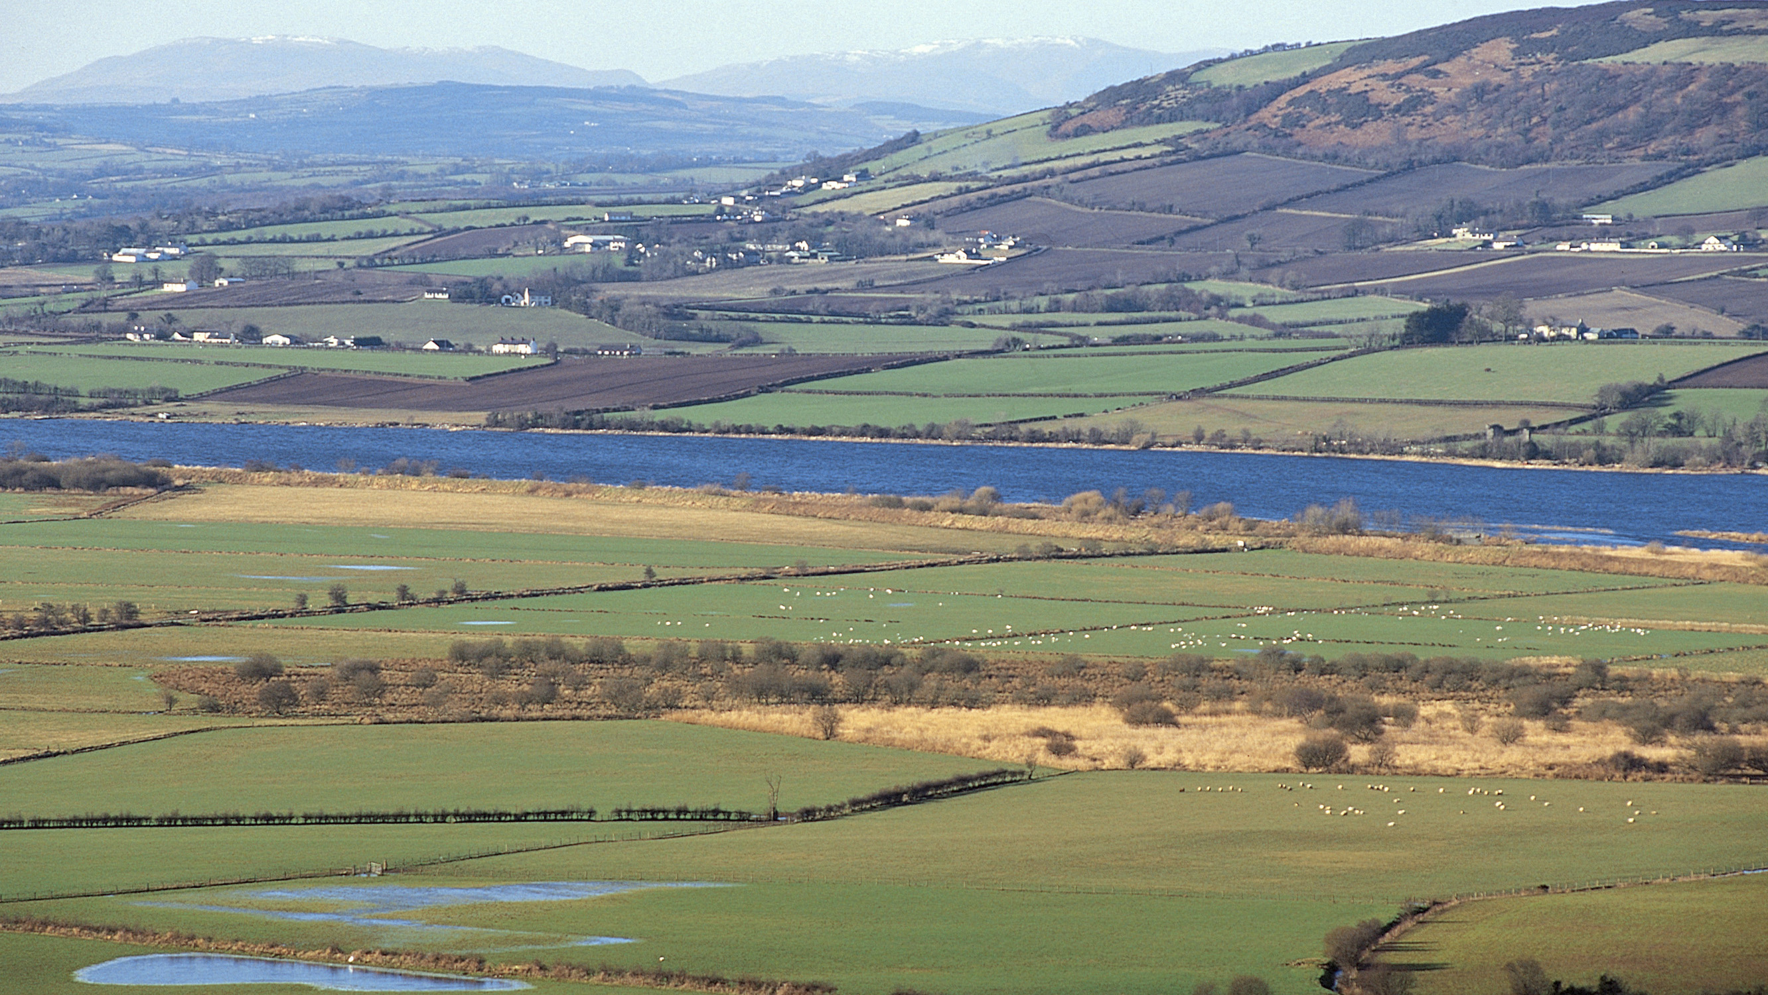
Divergence with the EU
Single bio-geographic unit.
Ratcheting up ambition across our greatest shared asset
Different ambitions or measurements.
Actions in one area effects the other.
Floor not a ceiling of ambition.
Foyle fields, credit: Andy Hay

Slide 8
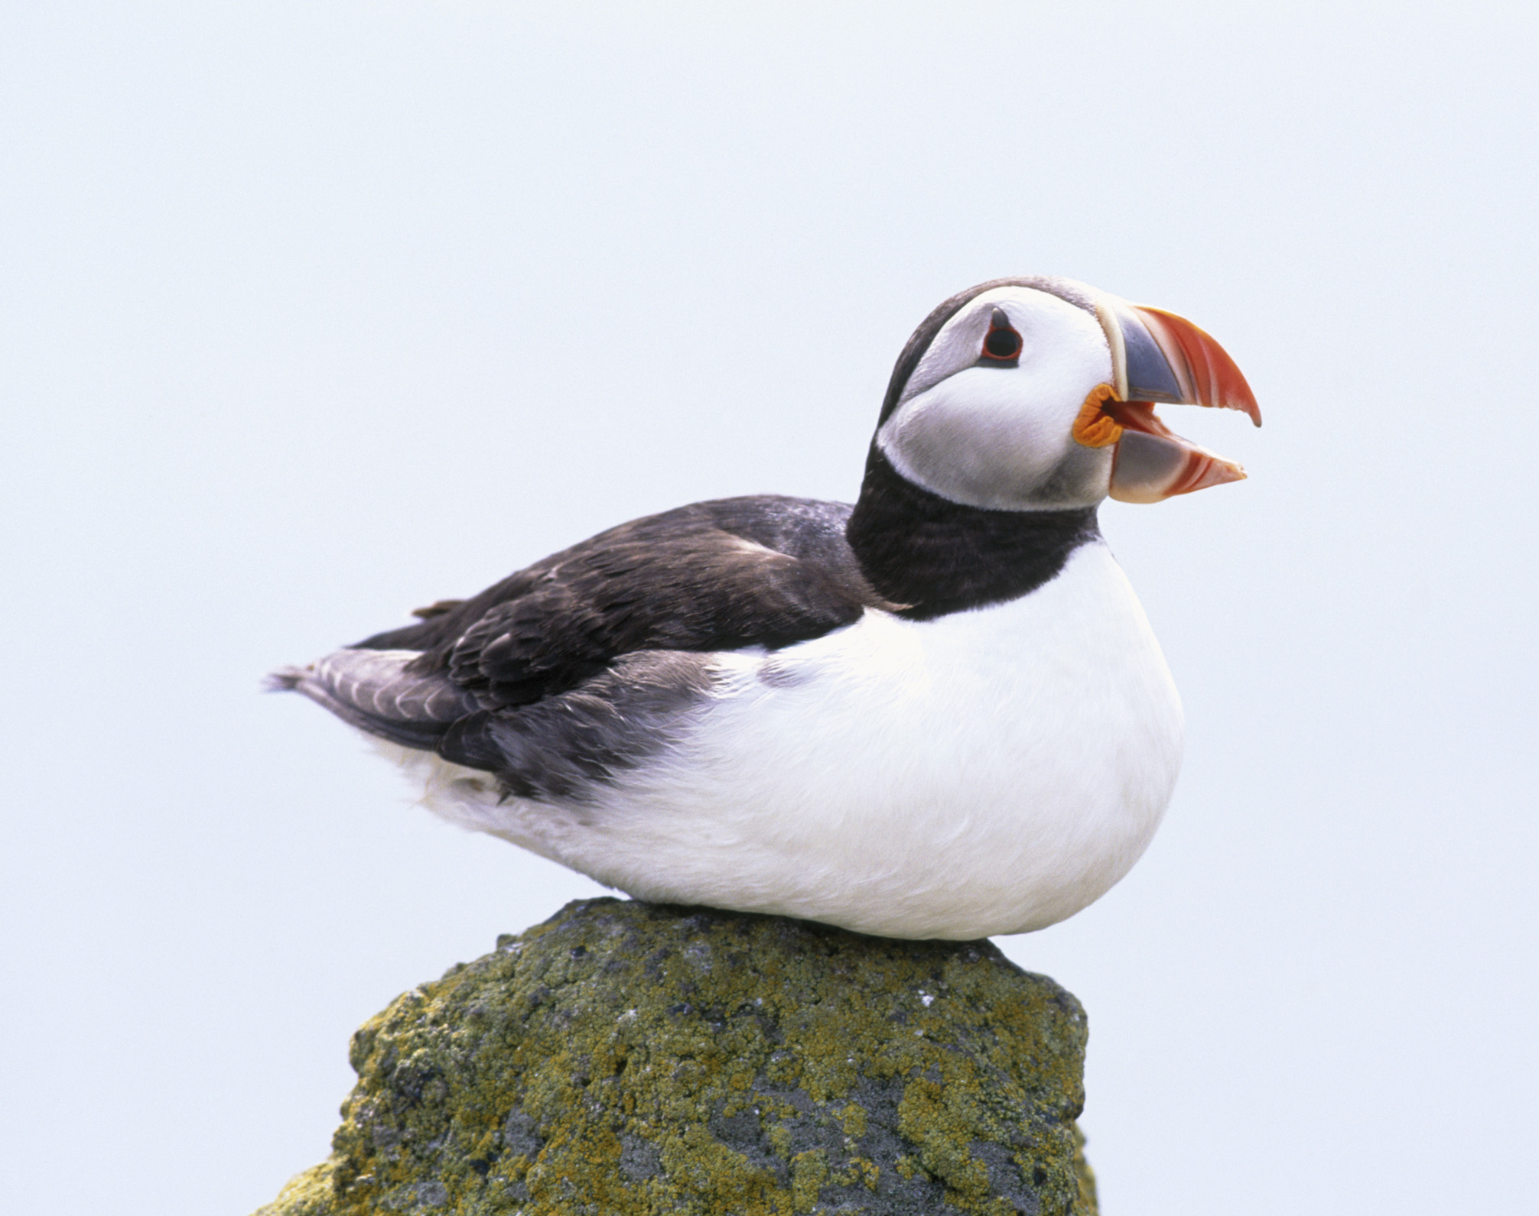
Thank you, any questions?
Dr. Jane Clarke
Jane.Clarke@rspb.org.uk
Puffin, Credit: Andy Hay

