Slide 1
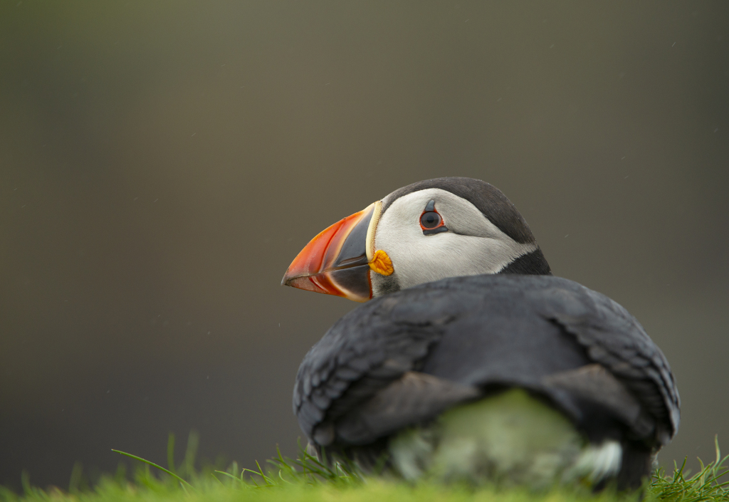
Nature targets in Scotland
September 2022
Puffin, photo credit: Ben Andrew
Notes:
Hi everyone, I’m Isobel and I work in the policy team at RSPB Scotland but I’m here today Scottish Environment LINK. Many thanks to IEEP for inviting us to take part today and for developing this really important report.
I’m just going to spend a few minutes running through the plans for targets here in Scotland and then I’ll talk briefly about some possible implications of intra-UK divergence and Scotland’s plans to stay aligned with the EU.

Slide 2
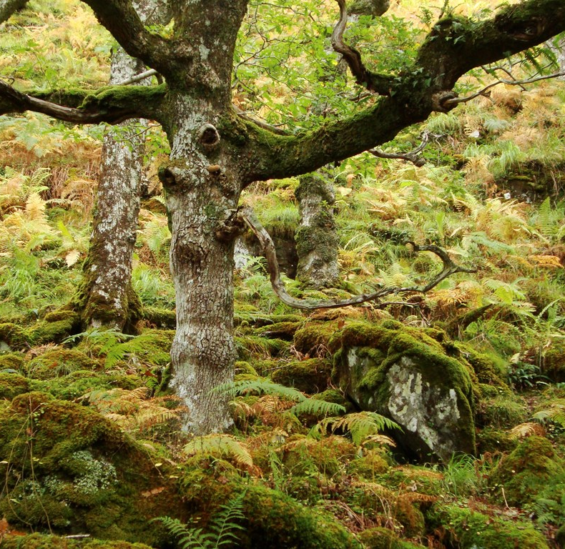
Nature Targets in Scotland
December 2020, Scottish Government signals step change in ambition on biodiversity loss and commits to ’30x30’
August 2021, Bute House Agreement commits to a Natural Environment bill with legally-binding nature restoration targets
Summer 2022, consultation on Scottish Biodiversity Strategy to 2045
Natural Environment Bill 2023/24
Notes:
Mirroring the global situation and the situation in the rest of the UK that we’ve already heard about today, Scotland’s nature is in trouble. The Biodiversity Intactness Index, ranked Scotland as coming 212th out of 240 countries and territories on how intact Scotland’s biodiversity remains. Whilst this metric shows historical losses, more recent data shows that we are still losing nature now, the State of Nature Scotland 2019 found that 49% of species have declined since 1970 and 1 in 9 species in Scotland is at risk of national extinction.
So, in the UN Decade of Ecosystem Restoration, the challenge has been shifting the narrative from talking about simply halting the loss of nature to restoration and regeneration of nature. Whilst we do not yet have legally binding nature targets in Scotland, it is hugely positive that we have indeed begun to see this substantial shift reflected in the rhetoric and commitments of the Scottish Government. We saw this as really starting in December 2020 when the Scottish Government published its Statement of Intent on Biodiversity,. Which set out the need for an urgent response to tackle the twin challenges of biodiversity loss and climate change and committed to 30x30
Then in August 2021 the Scottish Government and the Scottish Green Party established a cooperation agreement to work together in government for the next five years. This cooperation agreement was underpinned by something called the ‘Bute House Agreement’, a draft shared policy programme. This policy programme included a commitment to a Natural Environment Bill to be brought forward in 2023/24, which will include binding nature recovery targets, as well as key legislative changes to protect and restore nature and deliver 30x30.

Slide 3
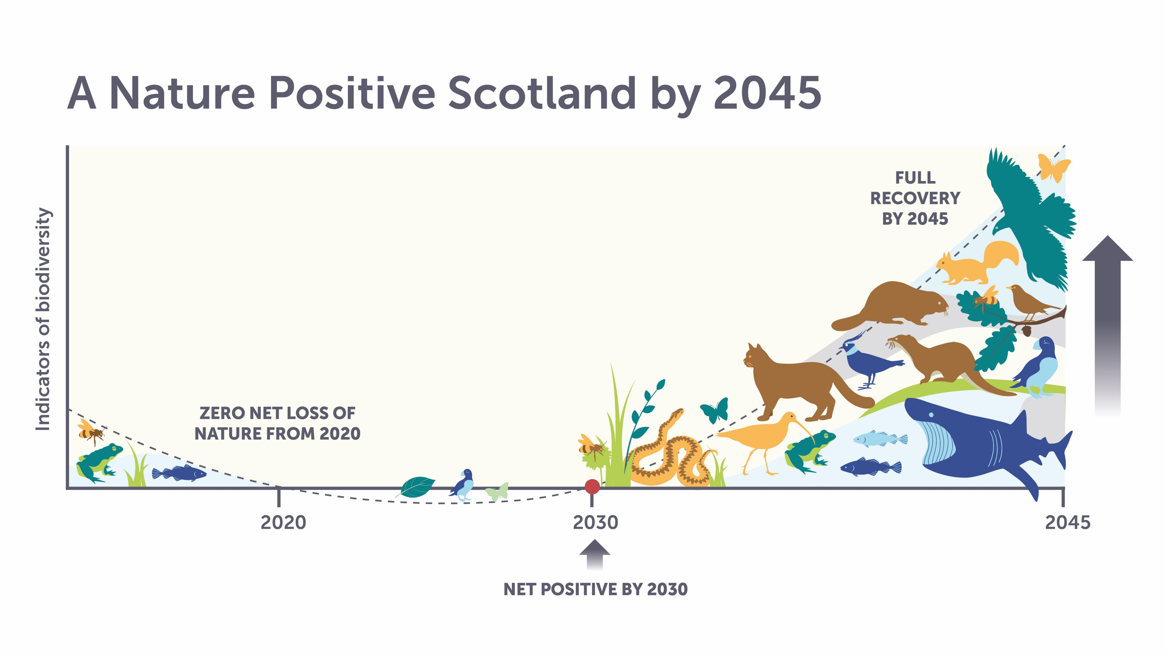
Nature targets in Scotland
Overarching goal of preventing any further extinctions of wildlife and halting declines by 2030, and making significant progress in restoring Scotland’s natural environment by 2045
Outcome targets covering:
  Species abundance
  Species distribution
  Extinction risk
  Habitat quality and extent
An effective, statutory target-setting monitoring, enforcing and reporting framework
Notes:
Specifically, the targets will be based on an overarching goal of preventing any further extinctions of wildlife and halting declines by 2030, and making significant progress in restoring Scotland’s natural environment by 2045. The Bill is also expected to include outcome targets that accommodate species abundance, distribution & extinction risk, and habitat quality and extent . That is hugely welcome as this matches the four elements of nature targets that Scottish Environment LINK and RSPB have been calling for in recent years. The Bill will also cover key actions to deliver our targets, including our agreement to protect 30% of Scotland’s land and seas by 2030, and highly protect 10%.
There is also a commitment to an effective, statutory target-setting monitoring, enforcing and reporting framework, which is crucial and welcome.
So, we have positive commitments to targets, we have unparalleled ambition on nature from the Scottish Government and we have for the first time ever Scottish Green Party ministers in government, specifically a green minister for Biodiversity, Lorna Slater. We really hope that all of this will put Scotland on a pathway to achieving Nature Positive by 2045. However, delivery is key and as ever the devil will be in the detail. We have some concerns about the timescales for the Bill and therefore hope to see an inclusive and consultative process kicking off really soon to develop the detail of what those targets will look like, taking into account what is happening elsewhere in the UK and the EU. A robust delivery plan and policies for meeting the targets will also be crucial and as I mentioned the Scottish Government have just consulted on their next Scottish Biodiversity Strategy to 2045. Unfortunately, this is an area where we feel that the substance hasn’t matched up to the rhetoric, and despite doing a great job at setting out the challenges, the strategy doesn’t include clear actions or targets for addressing the challenge so LINK is looking for some key changes that we think are crucial to the success of the strategy and I can pop a briefing in the chat bar for anyone that is interested.

Slide 4
Intra-UK divergence: implications for Scotland
Potential race to the bottom on environmental standards
Potential direct implications for Scotland from any weakening of some Westminster regulations
Complexity, especially for cross-border designations
Increased costs for separate approaches
However, commitment to EU alignment remains firm…
Notes:
So what might some of the potential intra-UK divergence we’ve heard about today mean for Scotland?
The most obvious is a potential race to the bottom on environmental standards across the UK, when we should be aiming for a race to the top, particularly in the face of an increasing deregulation agenda at Westminster
Looking at this in more detail, the picture is quite complex, and whilst environment is a devolved matter, some Westminster regulations do apply in Scotland under some specific circumstances, for example the Westminster Habitats Regulations apply in Scotland for electricity generating stations in excess of 50 megawatts, and so any weakening of those regulations at the Westminster level may have direct implications for nature in Scotland and this is something we have concerns about
There is also the potential for increased complexity and uncertainty in the regulatory landscape, which can pose challenges for businesses, local authorities and other stakeholders, for example potential for complexity with cross-border protected areas such as the Solway Firth SPA
Potential for increased costs and resourcing for separate approaches being developed across the UK, whilst often devolved administrations might choose to develop their own approach to nature protection due to distinct regional differences and needs, there may be more of a de-facto assumption to separate decision making and less resource pooling than we have seen in the past

Slide 5
Divergence or alignment with the EU
Strong commitment to maintain or exceed EU environmental standards
Keeping pace powers in the 2021 Continuity Act
Opportunities for Scotland to lead the way in progressive dynamic alignment that achieves nature positive outcomes
Notes:
There is a strong focus on EU alignment in Scotland, which is different context than the other UK countries. The Scottish Government has committed (repeatedly) to maintain or enhance EU environmental standards (EU alignment), which has been welcomed by LINK as a way to stay aligned with any nature positive laws that the EU brings forward. The Continuity Act 2021 then introduced powers for Scottish Ministers to keep pace with areas of EU law where they choose to and there is a requirement in the Act that when exercising those powers Ministers must have regard to an overall purpose of maintaining and advancing environmental, and other standards.There is therefore an opportunity for Scotland to lead the way in progressive dynamic alignment that achieves nature positive outcomes, and as a start LINK will be asking that the nature restoration targets now incorporate and reflect the EU restoration law, now that has come forward, with an ask for 20% of Scotland’s land and sea area to be under area-based restoration measures by 2030.

Slide 6
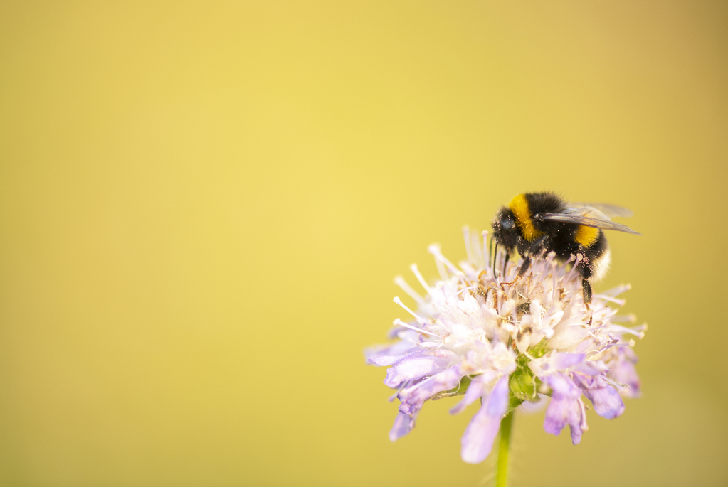
Get in touch with questions or feedback
Isobel Mercer
Isobel.mercer@rspb.org.uk
White-tailed bumblebee, Photo Credit: Ben Andrew
Notes:
That’s all from me, and happy to pick up any questions in the discussion.

